Slide 1
Zurich
Single Lock-In
Lee Jong Geon

Slide 2
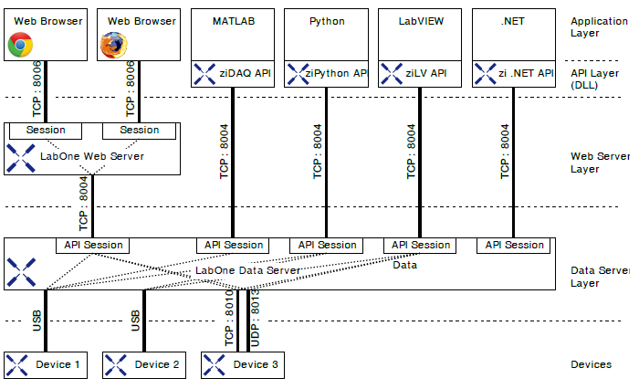
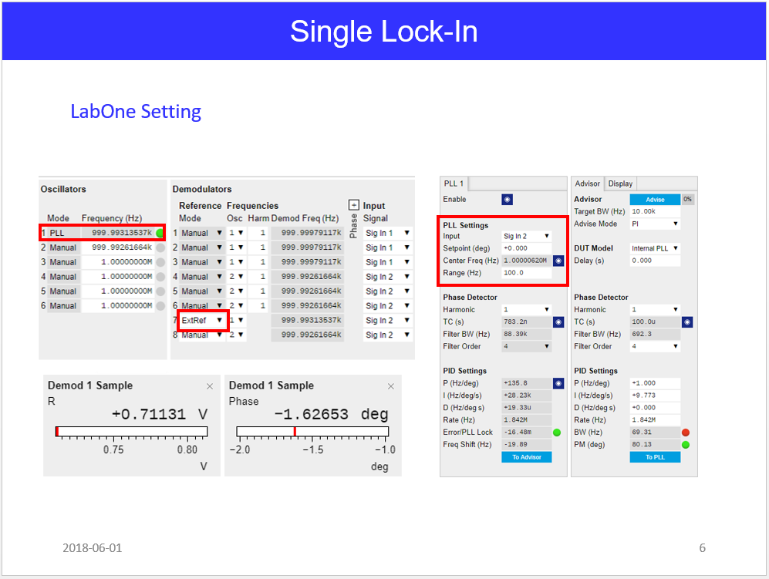
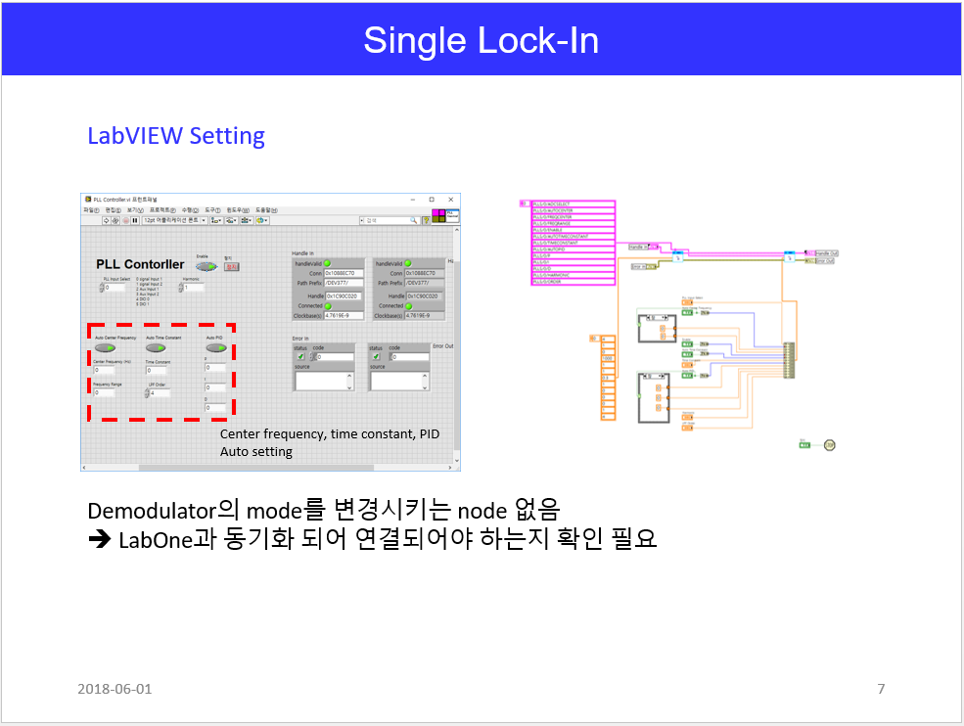
Last Points
Zurich LabOne - LabVIEW
➔ 독립적인 Interface

Slide 3
Single Lock-In
Device Connection
Function generator로 ext. reference와 input signal을 구현
Function Generator
(External reference)
output
1Vpp 1MHz
Signal
Zurich HF2LI
Ext.
Reference
Input 1
Output 1
Input 2
Output 2

Slide 4
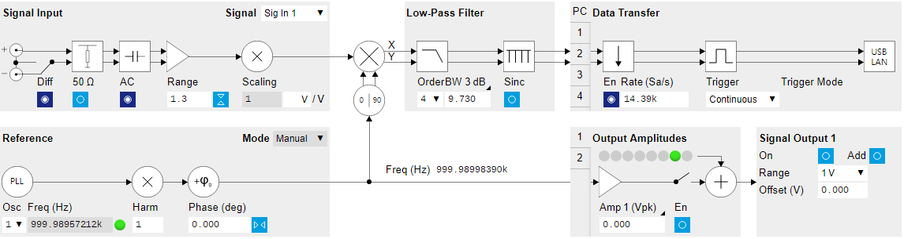
Single Lock-In
Diagram
Phase Lock Indicator

Slide 5
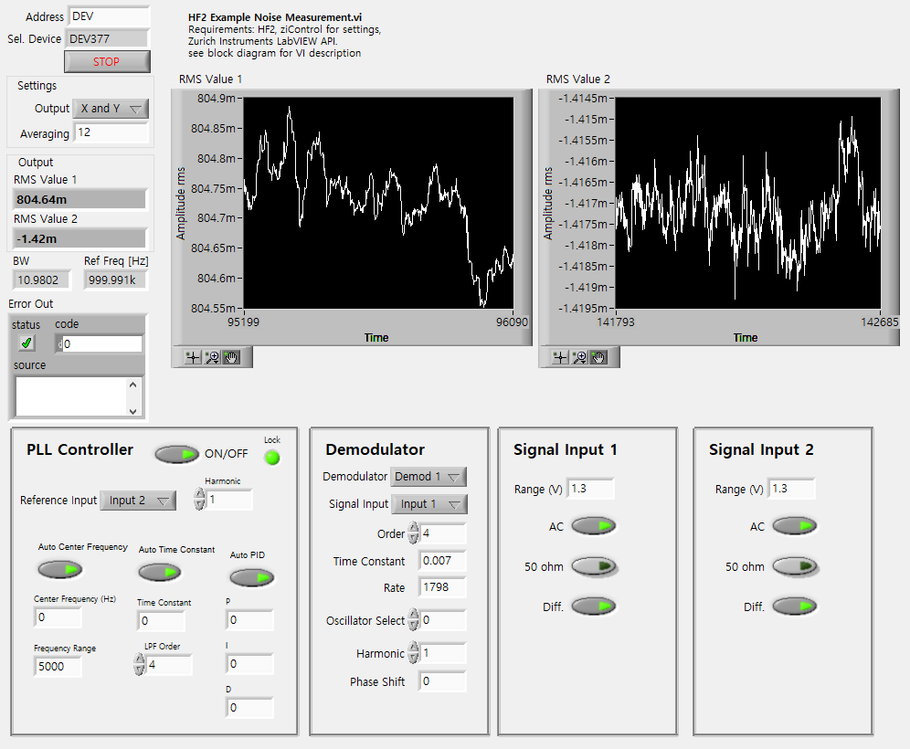
Single Lock-In (LabVIEW)

Slide 6
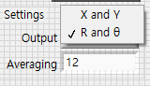
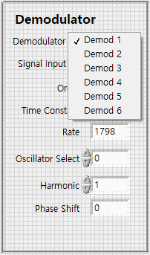
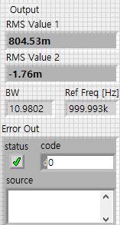

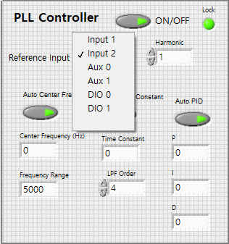
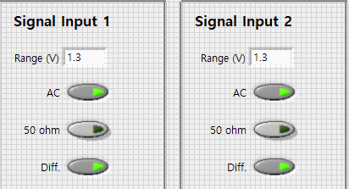
Single Lock-In (LabVIEW)
Display Settings
Demodulator Settings
Output
PLL Settings
Input Settings

Slide 7
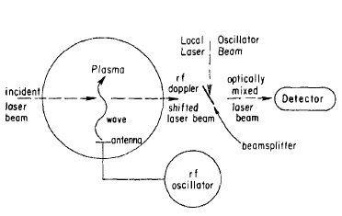
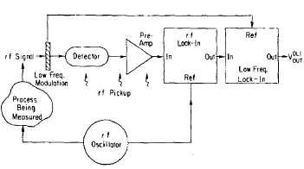
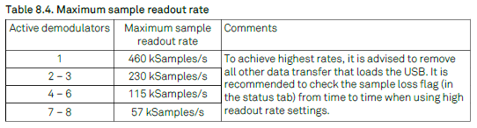
Dual Lock-In Design
Paper
Input Signal (1) + Reference Signal (2) = 3 Inputs
Input 1,2: 50MHz Bandwidth, 210MSamples/s
Aux 1, 2: 20kHz Bandwidth, 400kSamples/s
DIO 1, 2: 2MHz Bandwidth
Review of Scientific Instruments 56, 1662 (1985); doi: 10. 1063/1.1138121

Slide 8
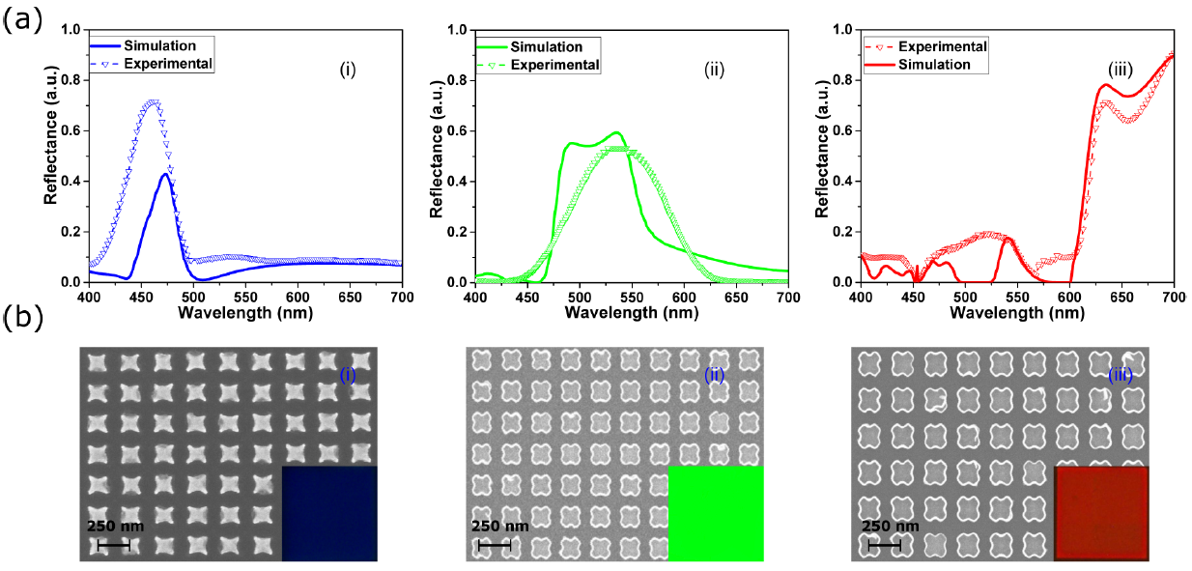
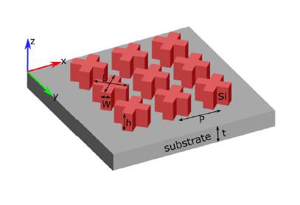
SKhynix
Paper
L = 85 nm and W = 46 nm for blue color
L = 114 nm and W = 62 nm for green color
L = 215 nm and W = 116 nm for red color.
Vishal Vashistha, Gayatri Vaidya, Ravi S. Hegde, Andriy E Serebryannikov, Nicolas Bonod, and Maciej Krawczyk . All-Dielectric Metasurfaces Based on Cross-Shaped Resonators for Color Pixels with Extended Gamut ACS Photonics 2017 4 (5), 1076-1082. DOI: 10.1021/acsphotonics.6b00853

Slide 9
Week Plan
 | May 5th wk. | June 1st wk. | June 2nd wk. | June 3rd wk. | June 4th wk.
PLL
Single LI Scope & Test
Dual LI Mixer Design
Dual LI Scope & Test

